Slide 1

COMPUTER GRAPHICS
Hochiminh city University of Technology
Faculty of Computer Science and Engineering
CHAPTER 02:
Graphics Programming
tgson@hcmut.edu.vn

Slide 2
OUTLINE
Introduction
OpenGL Libraries
Windows-based programming
A simple program
Viewing
Viewport
Primitives
Draw Object
The gasket

Slide 3
Introduction
Programming Environment
Hardware: display, graphics card
Software: OS (Windows), programming language (MS VC++), graphics library (OpenGL, DirectX)
OpenGL
Platform-independent API
Easy to use
Close enough to the hardware to get excellent performance
Treat 2D and 3D in the same way

Slide 4
OpenGL Libraries
OpenGL core library
OpenGL32 on Windows
GL on most unix/linux systems (libGL.a)
OpenGL Utility Library (GLU)
Provides functionality in OpenGL core but avoids having to rewrite code
Links with window system
GLX for X window systems
WGL for Windows
AGL for Macintosh

Slide 5
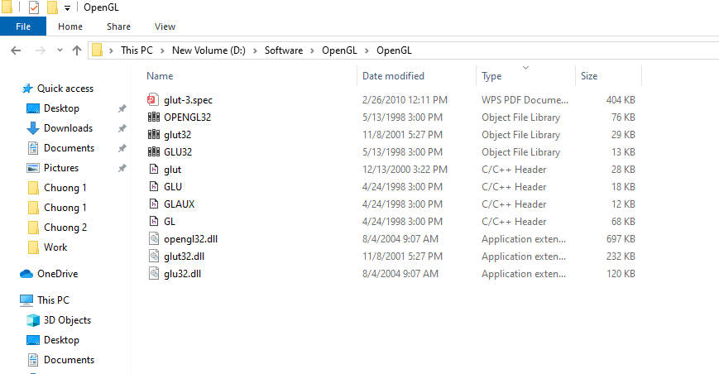
OpenGL Libraries

Slide 6
OpenGL Libraries
OpenGL Utility Toolkit (GLUT)
Provides functionality common to all window systems
Open a window
Get input from mouse and keyboard
Menus
Event-driven
Code is portable but GLUT lacks the functionality of a good toolkit for a specific platform
No slide bars

Slide 7
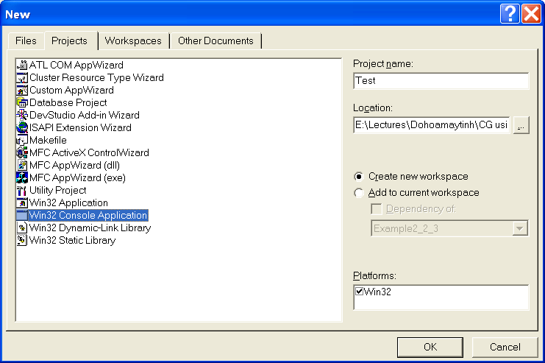
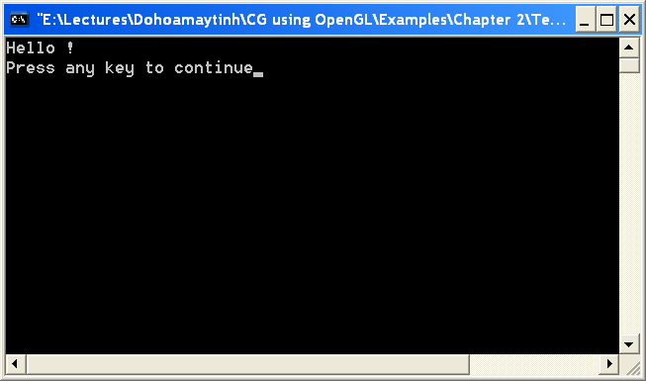
OpenGL Libraries

Slide 8
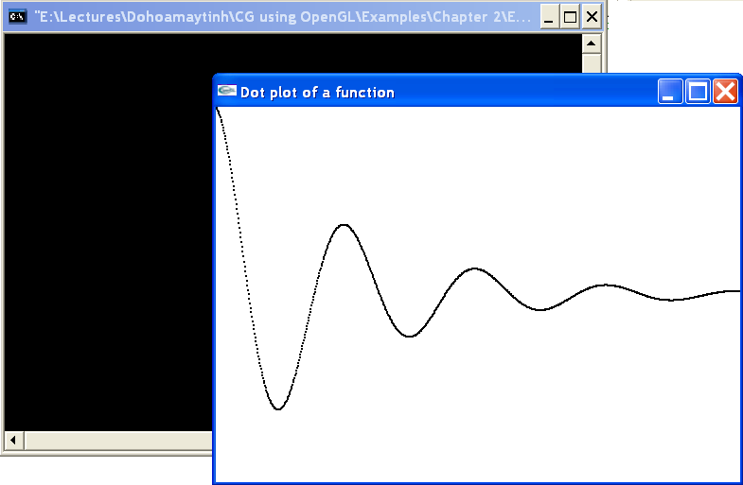
OpenGL Libraries

Slide 9
OpenGL Libraries

Slide 10
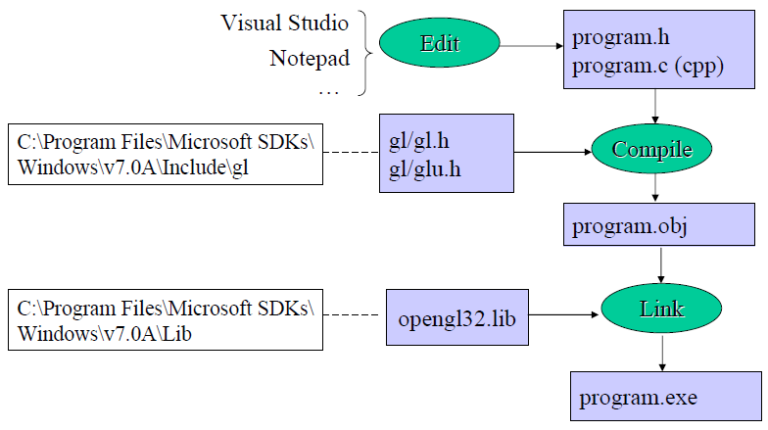
OpenGL Libraries

Slide 11
OpenGL Libraries

Slide 12
OpenGL Libraries
OpenGL Functions
Primitives
Points
Line Segments
Polygons
Attributes
Transformations
Modeling
Viewing
Control (GLUT)
Input (GLUT)
Query

Slide 13
Windows-based programming
Event-driven programming
Event queue
Callback function
Register callback function
glutDisplayFunc(myDisplay)
glutReshapeFunc(myReshape)
glutMouseFunc(myMouse)
glutKeyboardFunc(myKeyboard)

Slide 14
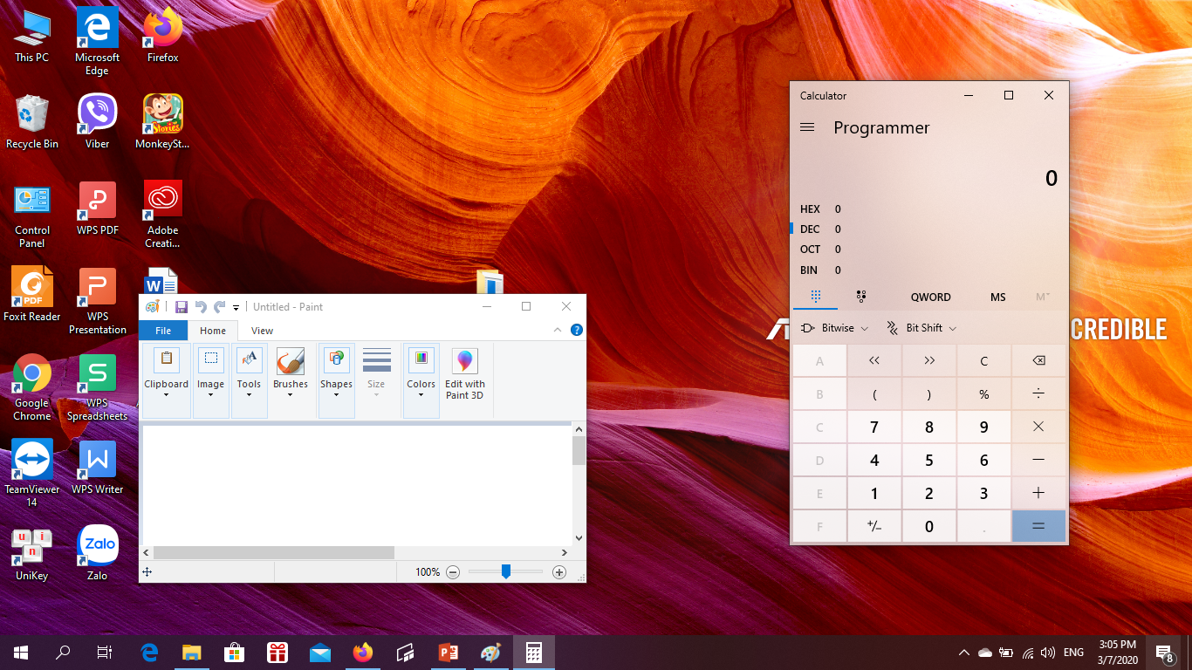
Windows-based programming
Event Queue

Slide 15
Windows-based programming
Event Queue
ID:….
Event:…
X: …
Y: …
……

Slide 16
Windows-based programming
Event Queue

Slide 17
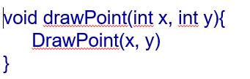
Windows-based programming
Event Queue

Slide 18
A simple program
Generate a square on a solid background

Slide 19
A simple program
#include <GL/glut.h>
void mydisplay(){
glClear(GL_COLOR_BUFFER_BIT);
glBegin(GL_POLYGON);
glVertex2f(-0.5, -0.5);
glVertex2f(-0.5, 0.5);
glVertex2f(0.5, 0.5);
glVertex2f(0.5, -0.5);
glEnd();
glFlush();
}
int main(int argc, char** argv){
glutCreateWindow("simple");
glutDisplayFunc(mydisplay);
glutMainLoop();
}

Slide 20
Structure of the program

Slide 21
Structure of the program

Slide 22
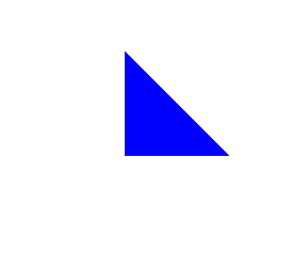
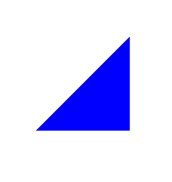
Viewing
A=(1, 1); B=(3, 1); C=(1, 3)
y
y
x
x

Slide 23
Viewing
Default Coordinate System
X axis: -1, 1; Y axis: -1, 1
Objects (parts of Object) outside will be clipped

Slide 24
Viewing
glBegin(GL_POLYGON);
glVertex2f(-0.5, -0.5);
glVertex2f(-0.5, 0.5);
glVertex2f(0.5, 0.5);
glVertex2f(0.5, -0.5);
glEnd();
1
-1
1
-1

Slide 25

Viewing
glBegin(GL_POLYGON);
glVertex2f(1.0, 1.0);
glVertex2f(1.0, 2.0);
glVertex2f(2.0, 2.0);
glVertex2f(2.0, 1.0);
glEnd();
1
-1
1
-1

Slide 26

Viewing
glBegin(GL_POLYGON);
glVertex2f(0.5, 0.5);
glVertex2f(0.5, 1.5);
glVertex2f(1.5, 1.5);
glVertex2f(1.5, 0.5);
glEnd();
1
-1
1
-1

Slide 27
Viewing
glMatrixMode (GL_PROJECTION);
glLoadIdentity();
glOrtho(-1.0, 1.0, -1.0, 1.0, -1.0, 1.0);
glMatrixMode (GL_PROJECTION);
glLoadIdentity();
glOrtho(-1.0, 1.0, -1.0, 1.0)
glOrtho(left, right, bottom, top, near, far)
gluOrtho2D(left, right,bottom,top)

Slide 28
Viewing
2
-2
4
-4

Slide 29
Viewing
glBegin(GL_POLYGON);
glVertex2f(-2.0, 0.0);
glVertex2f(-2.0, 2.0);
glVertex2f(0.0, 2.0);
glVertex2f(0.0, 0.0);
glEnd();
glBegin(GL_POLYGON);
glVertex2f( 0.0, -4.0);
glVertex2f( 2.0, 0.0);
glVertex2f( 4.0, -4.0);
glEnd();

Slide 30
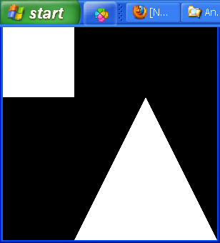
Viewing
How to get the picture of triangle and square?
2
-2
4
-4

Slide 31
Viewing
How to get the picture of triangle and square?
glMatrixMode (GL_PROJECTION);
glLoadIdentity();
gluOrtho2D(-2.0, 4.0, -4.0, 2.0);
How to get the picture of the square?
How to get the picture of the triangle?

Slide 32
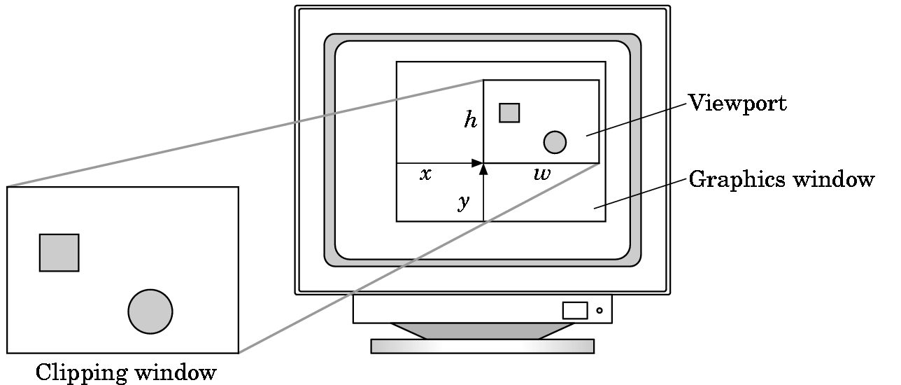
Viewport
Do not have use the entire window for the image: glViewport(x,y,w,h)
Values in pixels (screen coordinates)

Slide 33
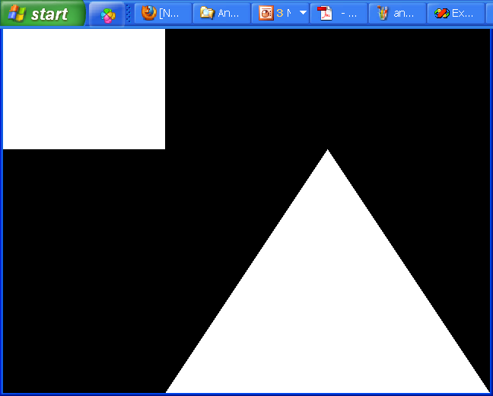
Viewport
Size of the graphics window
glutInitWindowSize(cx, cy);
glutInitWindowSize(640, 480);

Slide 34
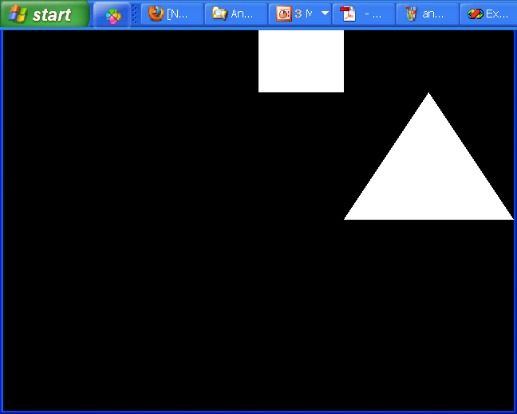
Viewport
glViewport(320, 240, 320, 240)

Slide 35
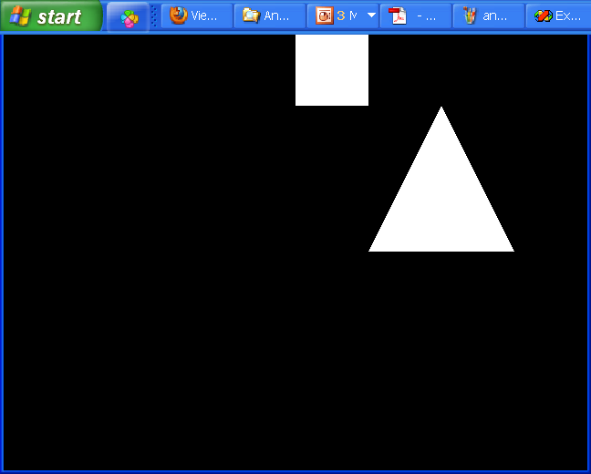
Viewport
glViewport(320, 240, 240, 240)

Slide 36
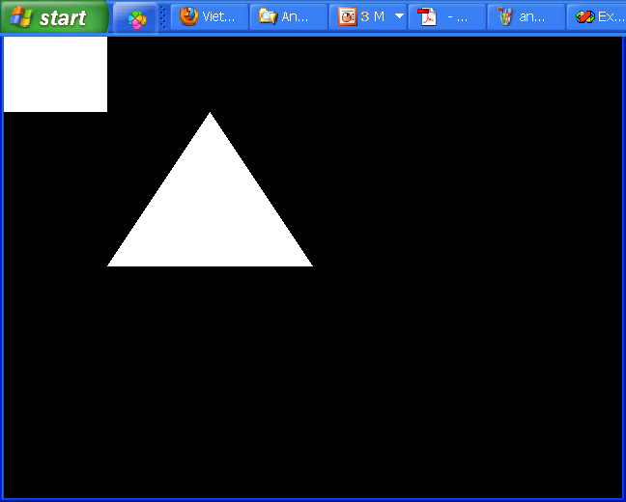
Viewport
How to draw picture in the second quadrant?

Slide 37
Viewport
How to draw picture in the second quadrant?
glViewport(0, 240, 320, 240);
How to draw picture in the third quadrant?
How to draw picture in the fourth quadrant?
How to draw picture in all quadrant?

Slide 38
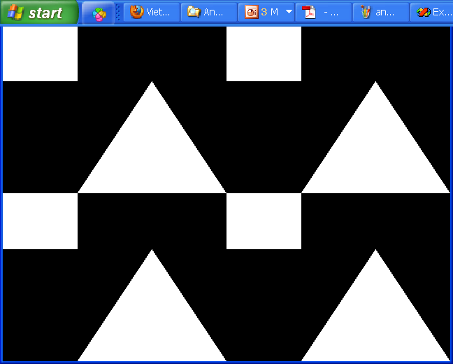
Viewport
How to draw picture in all quadrant?

Slide 39
Viewport
glViewport(320, 240, 320, 240);
glBegin() //draw square
………………
glEnd()
glBegin() //draw triangle
………………
glEnd()
glViewport(0, 240, 320, 240);
………………………………….
glViewport(0, 0, 320, 240);
………………………………….
glViewport(320, 0, 320, 240);
………………………………….

Slide 40
Primitives
Objects
Viewer
Light Source(s)
Materials
Polyline
Filled region
Text
Raster image

Slide 41
Primitives
Polyline
A polyline is a connected sequence of straight lines
A polyline can be used to approximated a smooth curve

Slide 42
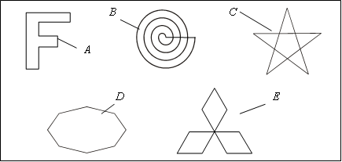
Primitives
Polyline
Polygon: polyline if the first and the last points are connected by an edge
Polygon type: simple, convex

Slide 43

Primitives
Polyline
Attributes: Color, thickness, type (solid, dash), join points

Slide 44
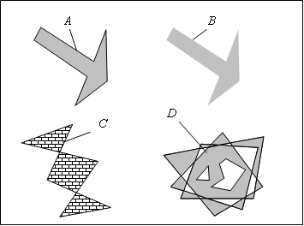
Primitives
Filled region
Filled region is a shape filled with some color or pattern. The boundary is often a polygon

Slide 45
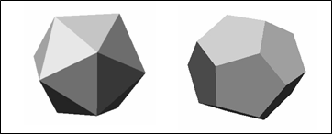
Primitives
Use filled region to shade the different faces of a three-dimensional object

Slide 46
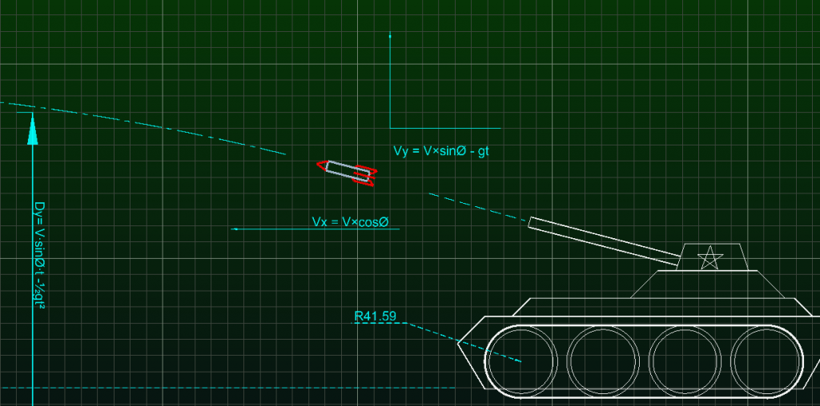
Primitives
Text

Slide 47
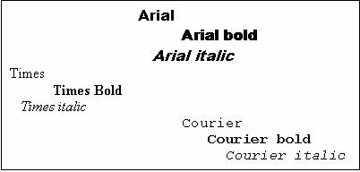
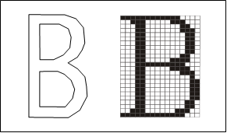
Primitives
Text:
Attributes: Font, color, size, orientation, space

Slide 48
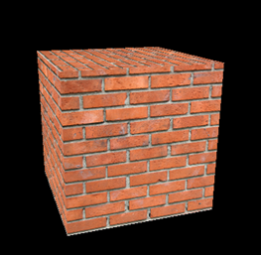
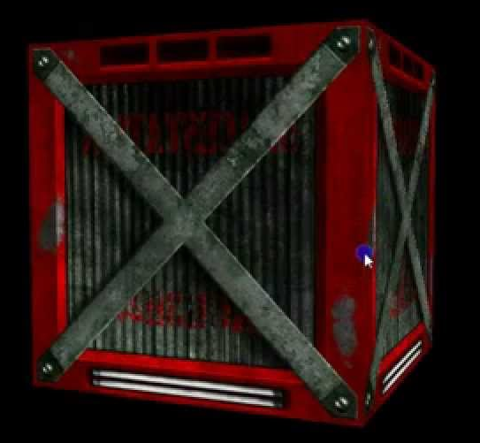
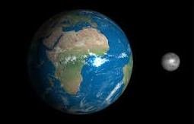
Primitives
Texture

Slide 49
Draw Object
glBegin(parameter)
glVertex2f(…) //or glVertex3f(…)
glVertex2f(…)
………………
glEnd()
Parameter
GL_POINTS, GL_LINES, GL_TRIANGLES, v.v

Slide 50
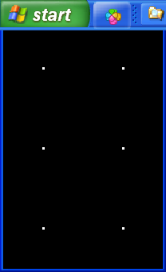
Draw Object
glBegin(GL_POINTS);
glVertex2f(-0.5, 1.0);
glVertex2f( 0.5, 1.0);
glVertex2f(-0.5, 0.0);
glVertex2f( 0.5, 0.0);
glVertex2f(-0.5, -1.0);
glVertex2f( 0.5, -1.0);
glEnd();

Slide 51
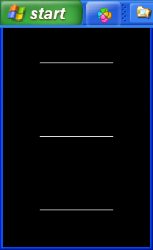
Draw Object
glBegin(GL_LINES);
glVertex2f(-0.5, 1.0);
glVertex2f( 0.5, 1.0);
glVertex2f(-0.5, 0.0);
glVertex2f( 0.5, 0.0);
glVertex2f(-0.5, -1.0);
glVertex2f( 0.5, -1.0);
glEnd();

Slide 52
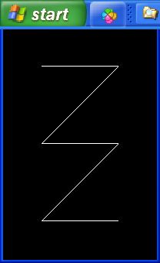
Draw Object
glBegin(GL_LINE_STRIP);
glVertex2f(-0.5, 1.0);
glVertex2f( 0.5, 1.0);
glVertex2f(-0.5, 0.0);
glVertex2f( 0.5, 0.0);
glVertex2f(-0.5, -1.0);
glVertex2f( 0.5, -1.0);
glEnd();

Slide 53
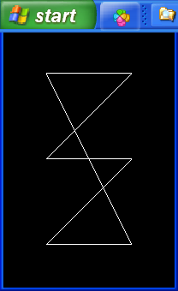
Draw Object
glBegin(GL_LINE_LOOP);
glVertex2f(-0.5, 1.0);
glVertex2f( 0.5, 1.0);
glVertex2f(-0.5, 0.0);
glVertex2f( 0.5, 0.0);
glVertex2f(-0.5, -1.0);
glVertex2f( 0.5, -1.0);
glEnd();

Slide 54
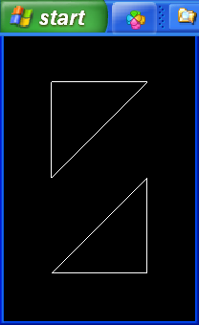
Draw Object
glBegin(GL_TRIANGLES);
glVertex2f(-0.5, 1.0);
glVertex2f( 0.5, 1.0);
glVertex2f(-0.5, 0.0);
glVertex2f( 0.5, 0.0);
glVertex2f(-0.5, -1.0);
glVertex2f( 0.5, -1.0);
glEnd();

Slide 55
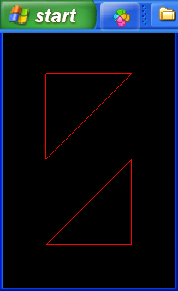
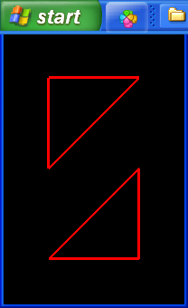
Draw Object
glPolygonMode(GL_FRONT_AND_BACK, GL_LINE);
glColor3f(1.0, 0.0, 0.0);
glLineWidth(3.0);

Slide 56
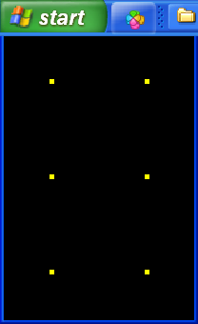
Draw Object
glPolygonMode(GL_FRONT_AND_BACK, GL_POINT);
glColor3f(1.0, 1.0, 0.0);
glPointSize(5);

Slide 57
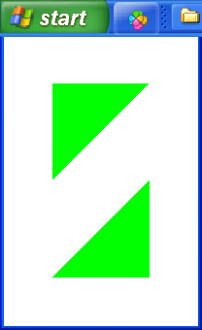
Draw Object
glPolygonMode(GL_FRONT_AND_BACK, GL_FILL);
glColor3f(0.0, 1.0, 0.0);
glClearColor(1.0, 1.0, 1.0, 1.0);

Slide 58
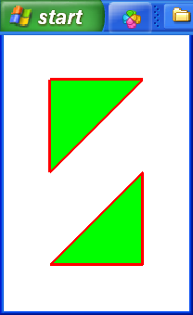
Draw Object

Slide 59
Draw Object
glPolygonMode(GL_FRONT_AND_BACK, GL_FILL);
glColor3f(0.0, 1.0, 0.0);
glClearColor(1.0, 1.0, 1.0, 1.0);
glBegin(GL_TRIANGLES);
……………………..
glEnd();
glPolygonMode(GL_FRONT_AND_BACK, GL_LINE);
glColor3f(1.0, 0.0, 0.0);
glLineWidth(3);
glBegin(GL_TRIANGLES);
……………………..
glEnd();

Slide 60
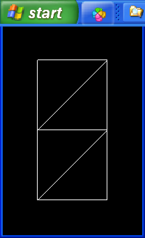
Draw Object
glBegin(GL_TRIANGLES);
glVertex2f(-0.5, 1.0);
glVertex2f( 0.5, 1.0);
glVertex2f(-0.5, 0.0);
glVertex2f(-0.5, 0.0);
glVertex2f( 0.5, 1.0);
glVertex2f( 0.5, 0.0);
glVertex2f(-0.5, -1.0);
glVertex2f(-0.5, 0.0);
glVertex2f( 0.5, 0.0);
glVertex2f( 0.5, 0.0);
glVertex2f(-0.5, -1.0);
glVertex2f( 0.5, -1.0);
glEnd();

Slide 61
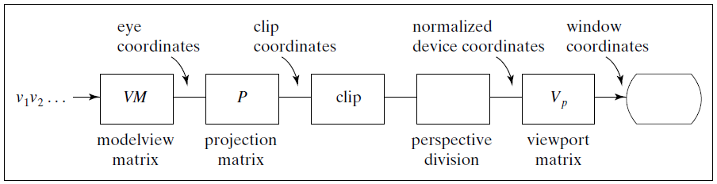
Draw Object

Slide 62
Draw Object
glBegin(GL_TRIANGLE_STRIP);
glVertex2f(-0.5, 1.0);//v1
glVertex2f( 0.5, 1.0);//v2
glVertex2f(-0.5, 0.0);//v3
glVertex2f( 0.5, 0.0);//v4
glVertex2f(-0.5, -1.0);//v5
glVertex2f( 0.5, -1.0);//v6
glEnd();

Slide 63
Draw Object
v1
v2
v1
v2
v3
v4
v3
v4
v5
v6
v5
v6
v1, v2, v3, v4, v5, v6
v2, v1, v4, v3, v6, v5

Slide 64
Draw Object
GL_QUADS, GL_QUAD_STRIP, GL_TRIANGLE_FAN
GL_POLYGON
GL_TRIANGLES
GL_TRIANGLE_STRIP
GL_TRIANGLE_FAN
v₂
v₁
v₂
v₀
v₄
v₃
v₁
v₀
v₃
v₄
GL_QUADS
GL_QUAD_STRIP
v₀
v₄
v₂
v₆
v₁
v₇
v₃
v₅

Slide 65
Draw Object
void drawPoint(GLint x, GLint y) {
glBegin(GL_POINTS);
glVertex2i(x, y);
glEnd();
}
void drawLine(GLint x1, GLint y1, GLint x2, GLint y2){
glBegin(GL_LINES);
glVertex2i(x1, y1);
glVertex2i(x2, y2);
glEnd();
}

Slide 66
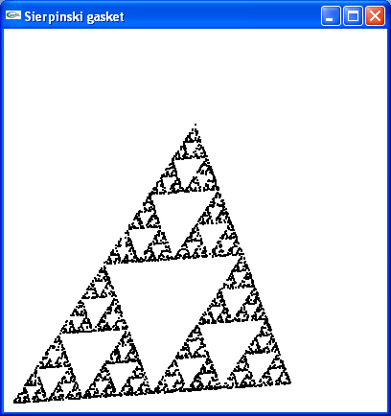
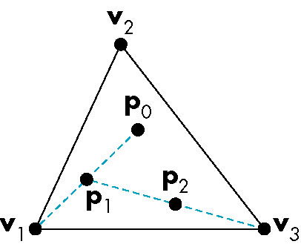
The Sierpinski Gasket

Slide 67
The Sierpinski Gasket
Pick an initial point (x, y, z) at random inside the triangle
Select one of the three vertices at random
Find the location halfway between the initial point and the randomly selected vertex
Display this new point by putting some sort of marker, such as a small circle at the corresponding location on the display
Replace the point at (x, y, z) with this new point
Return to step 2

Slide 68
The Sierpinski Gasket
main()
{
Initialize_the_system();
for(some_number_of_points)
{
pt = generate_a_point();
Display_the_point(pt);
}
}

Slide 69
The Sierpinski Gasket
void myinit()
{
glClearColor(1.0, 1.0, 1.0, 1.0); /* white background */
glColor3f(1.0, 0.0, 0.0); /* draw in red */
glMatrixMode(GL_PROJECTION);
glLoadIdentity();
gluOrtho2D(0.0, 50.0, 0.0, 50.0);
glMatrixMode(GL_MODELVIEW);
}

Slide 70
The Sierpinski Gasket
void display( void ){
GLfloat vertices[3][2]={{0.0,0.0},{25.0,50.0},{50.0,0.0}}; /* A triangle */
int j, k;
srand(time(NULL)); /* standard random number generator */
GLfloat p[2] ={7.5,5.0}; /* An arbitrary initial point inside traingle */
glClear(GL_COLOR_BUFFER_BIT); /*clear the window */
glBegin(GL_POINTS);
for( k=0; k<5000; k++) {
j = rand()%3; /* pick a vertex at random */
p[0] = (p[0]+vertices[j][0])/2.0;
p[1] = (p[1]+vertices[j][1])/2.0;
glVertex2fv(p);
}
glEnd();
glFlush(); /* clear buffers */
}

Slide 71
Further Reading
“Interactive Computer Graphics: A Topdown Approach Using OpenGL”, Edward Angel
Chapter 2: Graphics Programming
“Đồ họa máy tính trong không gian hai chiều”, Trần Giang Sơn
Chương 2: Bước đầu tạo hình ảnh
“Đồ họa máy tính trong không gian ba chiều”, Trần Giang Sơn
Chương 1: Mô hình hóa đối tượng ba chiều bằng lưới đa giác

